Slide 1



Welcome to the “Step Up” – BT live online career challenge
What will you need?
A good wi-fi connection
A notebook and pen
A quiet environment where you will not be disturbed for 40 minutes!
What do we expect?
Respectful and appropriate behaviour throughout this 40-minute briefing session
A positive attitude and a willingness to learn
There will be a number of opportunities throughout today’s presentation to ask questions using the chat function.
Please raise your hand if you need any assistance.
How will you benefit from completing this challenge?
The opportunity to solve BT’s business problem
To learn about how your current course can be applied to a career in data
Understand how valuable YOUR “Key skills” are when solving this problem and delivering the solution.
Gain a virtual work experience certificate
Any technical issues during this session – please email us on: info@digdata.online

Slide 2

BT Career Challenge
Step Up

Slide 3


Meet us
Isabelle Tontchev
Data Engineering Professional
Cycled the Dunwich Dynamo in 2019, a 120 mile ride through the night and is training for the London to Brighton this year.
Was an Accountant before she pivoted into Data
Reyhaneh Hashempour
Data Science Professional
Has lived, worked, and studied in 5 different countries for the last 6 years
Always has had a privilege of having fantastic people around her

Slide 4



A bit about BT
BT Group
Consumer
Digital &
Innovation
Global
Enterprise
Networks
Openreach

Slide 5
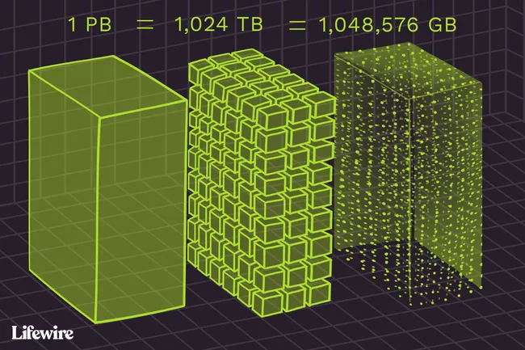
A bit about BT
BT was founded in ____, which was then called electronic telegraph company. It was the world’s first telegraph company. It was a public limited company up until 1982, when it was privatised.
BT employs 104,000 people around the world, including __,___ people in the UK and has offices in UK & Ireland, Europe, Americas, Asia, Middle East and Africa.
BT holds over __ Petabytes of data.
BT has the second/ third largest Hadoop cluster in Europe

Slide 6
Data types
float
string
array
int
char
Data types
timestamp
datetime
bool

Slide 7










What kind of tools do we use?

Slide 8
Why are some customers leaving us?
Can you help us understand why some customers stop using our services?
Approach A
Can you help the Strategy Analyst team?
Approach B
Can you help the Data Science team?

Slide 9
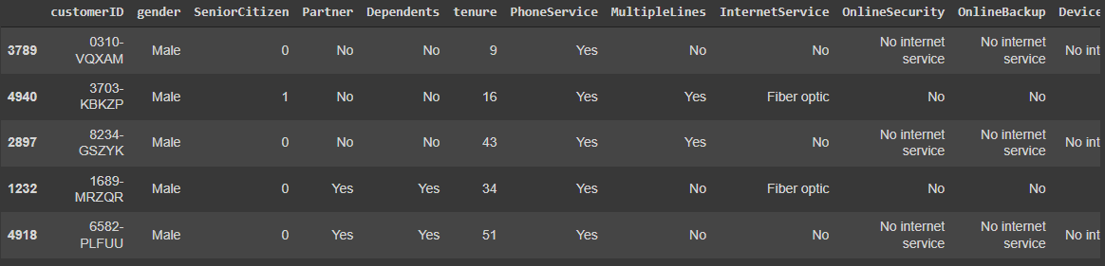
Data Snapshot
7043 rows of data containing customers attributes and whether they left the company or not.
It’s not real BT data, but it’s similar to what we use every day.

Slide 10
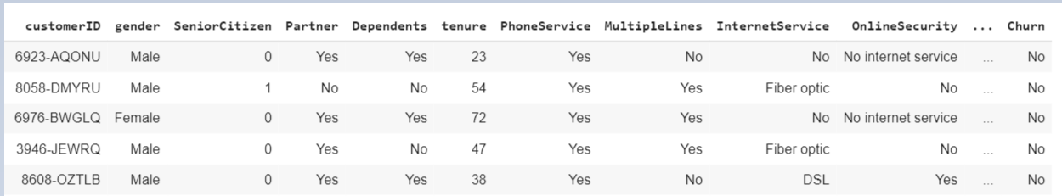
Data Snapshot
If the person is a senior citizen or not?
Yes=1, 0=No
If the person has left the company?
How many months the person has been with us?
Notes:
Colour one of lines. Can you tell us what that line of data is telling.

Slide 11
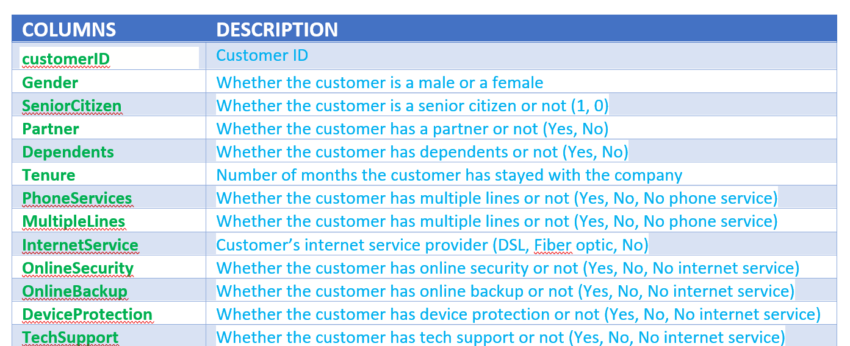
Data Snapshot
In the guide document there is a table that tells you all about the different columns

Slide 12
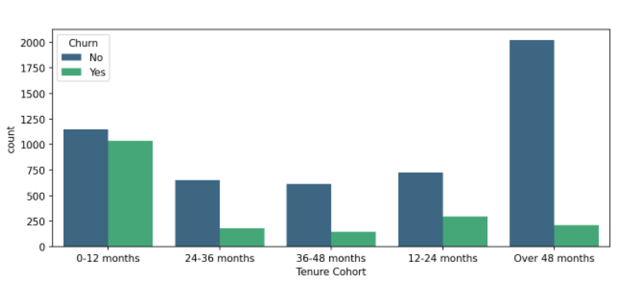
Initial Data Analysis
We recommend that you dive into the data and see what you can find?
For example, the graph shows how the number of customers leaving the company varies by the number of months they’ve been with us.
Notes:
Ask audience, what do they recognise in this graph?
What is this graph telling us?

Slide 13

Approach A
Can you help the Strategy Analyst team?
Notes:
What does a strategy analyst do?
Differentiate between DS and Strategy Analyst

Slide 14
Can you help the Strategy Analyst team?
We want to split our customers into segments with common habits (Churn/not Churn)?
We would like to understand our customers better and offer them services, so they stay with us. To help us understand our customers, you can split them into segments and describe the characteristics of each segment:
Churn
Not Churn

Slide 15
Can you help the Strategy Analyst team?
We want to split our customers into segments with common habits (Churn/not Churn)?
When you have created the segments, can you give us a summary about them? What key actions could we take to improve our relationship with our customers?
For each segment:
What is the age profile? (being a senior citizen/not)
How about customers with/without dependents?
What is the status of customers contract length?
How should we communicate with them?
Notes:
How do we have to communicate with customers differently?
Send through the post, do stuff on online.
If family is growing, can we offer a bundle?

Slide 16
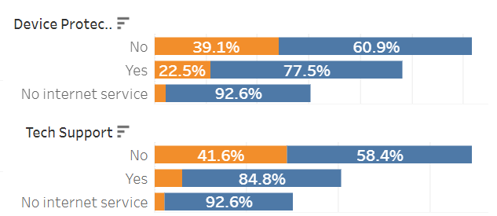
Can you help the Strategy Analyst team?
Device Protection: The churn count and rate of groups that do not use device protection services are doubled.
Tech Support: The churn count and rate of groups that do not use Tech support are three times higher.
Notes:
What suggestions do you have that we may not have considered here?
What other features, attributes can we collect?
What are other brands doing that we are not doing?
You experience.

Slide 17
Approach B
Can you help the Data Science team?
Notes:
Can anyone tell us what the data science does?

Slide 18
Can you help the Data Science team?
Build a model that predicts which customers are highly likely to leave us
Interpret the model to understand what influences the customers’ decision to leave
Make recommendations to the business:
How could we engage the customers to stay with us?
How could we retain more customers?
1
2
3
Notes:
Explain why it is important to interpret the model?
It is important to present back, why are we doing this?
Most predictive features.
Reduce number of features we use
Save computational resources

Slide 19
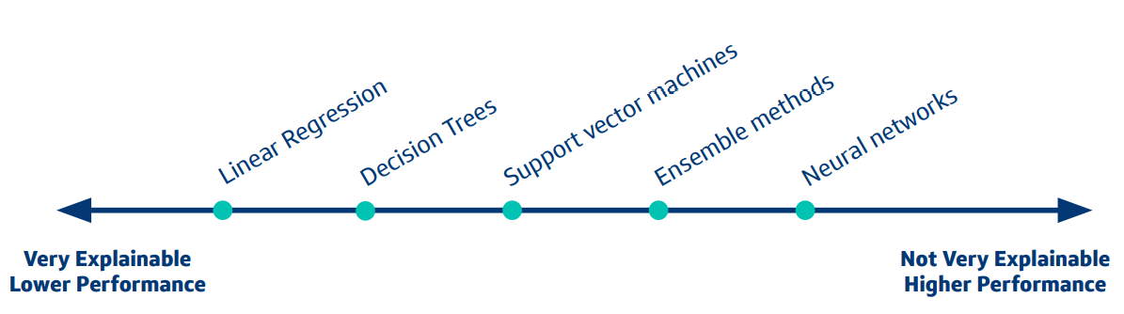
Advice for Building Your Model
Use any environment you are comfortable in: e.g. Python, R,…
Use any model you think is appropriate: that could be logistic regression, a tree based model or Neural networks-Keep in mind that you need to explain your model

Slide 20
Other Things to Consider
Question | Ideas
What measure will you use to evaluate the performance of your model? | Accuracy, Precision, Recall, F-score?
How will you split your data? | Train and Test, Train, Evaluation and Test, or K-fold
How will you handle null values? Outliers? | You can drop them, impute them, etc.
How you are going to treat the imbalanced dataset? And why you need to consider this? | Over sampling, under sampling?

Slide 21
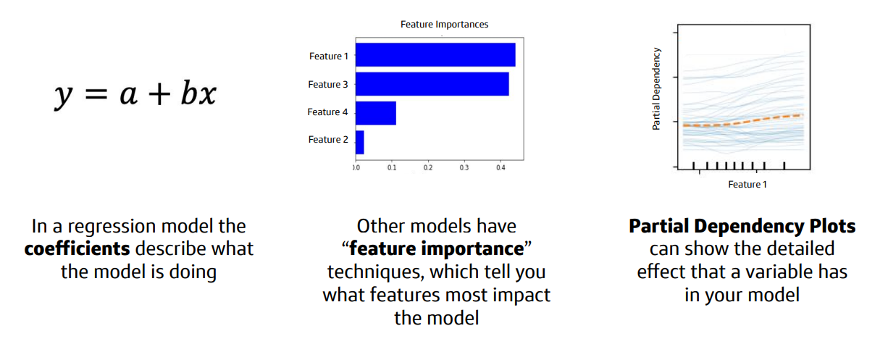
How to interpret your model results

Slide 22
Using your model to make recommendations
What does your model tell you is most predictive of higher rate of churning? How could we keep these customers happy so that they stay with us?

Slide 23
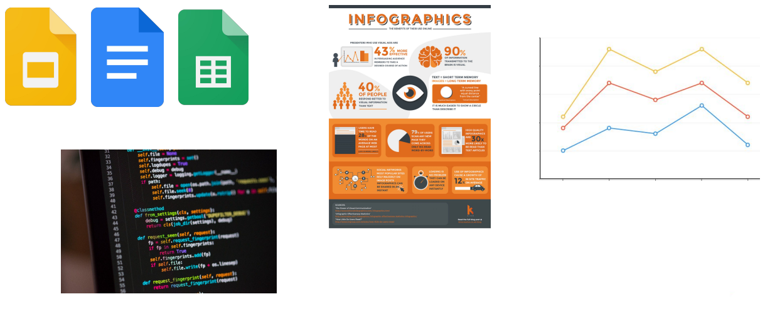
Presenting your Results
How are you going to present your results? Remember your audience are business managers, not analysts or coders

Slide 25


What happens now?
Digdata will send you:
Briefing document
Data set (Excel worksheet)
Hints & Tips fact sheet
Recorded session link
When is the BT challenge deadline?
Friday 20th May at 6pm
How can you present your solution?
Infographics
Graphs / charts
Code
Text / bullet points
Send all of your work to info@digdata.online and you will receive your virtual work experience certificate within 7 days.

